Slide 1
PHISHGUARD
An Explainable AI Approach for Email Threat Detection

Slide 2
Agenda
Introduction
Problem Statement
Data Preprocessing
Auto-Encoder
Random-Forest
Performance Metric
Graphs

Slide 3
Muhammad Abdullah Khan Mahsud
2023346
Muhammad Zaeem Nawaz
2023550
Muhammad Bin Waseem
2023403
Muhammad Shaheer
2023509

Slide 4
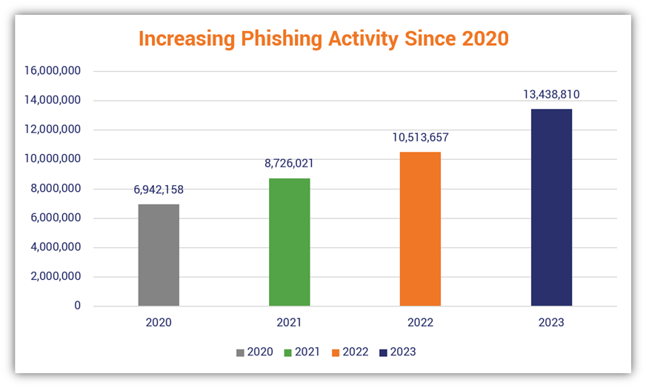
PROBLEM STATEMENT
What is Phishing :
A social engineering attack that tricks recipients into revealing sensitive information. Often done through emails and fake URLs.
THREATS :
Traditional defenses fail against sophisticated, AI-enhanced phishing.
Phishing is the #1 gateway to catastrophic data breaches and financial loss.
Sophisticated techniques render keyword filters obsolete.
We require a robust defense to detect subtle, non-obvious malicious patterns.

Slide 5
DATA PREPROCESSING
The dataset consists of labeled phishing and legitimate emails collected from publicly available sources. Real-world issues such as mixed encodings, missing values, and inconsistent labels are addressed using a robust preprocessing pipeline.
Key preprocessing steps include:
• Safe CSV loading with multi-encoding support
• Text normalization and cleaning
• Feature scaling using StandardScaler
• Class imbalance handling using SMOTE

Slide 6
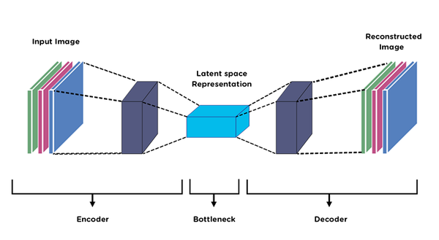
AUTO-ENCODER
What is Auto-Encoder:
An autoencoder is an unsupervised neural network that learns efficient data representations by compressing input data into a lower-dimensional "code" (encoding) and then reconstructing the original input from this code.
Role in Project:
Dimensionality Reduction (learning a compressed, essential representation of the email data)
Anomaly Detection (detecting unusual patterns/noise in phishing emails)

Slide 7
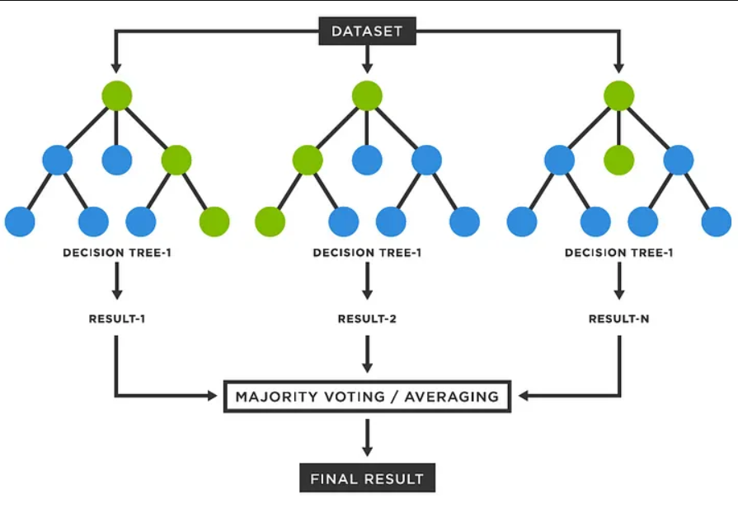
RANDOM FOREST
A random forest is a supervised machine learning algorithm that builds and combines a multitude of individual decision trees to produce a more accurate and stable prediction.
Why RF is used:
it combines many decision trees to create a powerful, accurate model that reduces overfitting.
Role in Project:
Final Classifier on the refined/reconstructed features from the Autoencoder.

Slide 8

RESULTS AND EVALUATION

Slide 9
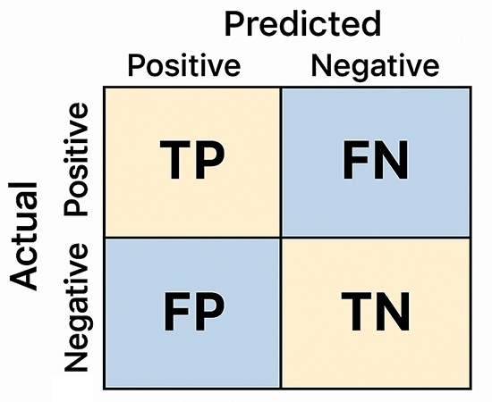
PERFORMANCE METIRCS
ACCURACY :
The overall percentage of all emails that were classified correctly.
PRECISION :
model's reliability; Minimize False Alarms
RECALL :
Measures the model's coverage; Detects the vast majority of actual phishing emails.
F1 Score :
Balances False Alarms (precision) and Missed Threats (Recall).
ROC AUC :
Ranks phishing emails higher than legitimate emails (probability across all thresholds).

Slide 10
RESULTS METRICS
Metric | RF | AUTOENCODER+RF
ACCURACY | 89.88% | 96.29%
PRECISION | 84.95% | 94.80%
RECALL | 96.93% | 96.66%
F1-SCORE | 90.54% | 95.72%
ROC AUC | 92.4% | 99.38%

Slide 11
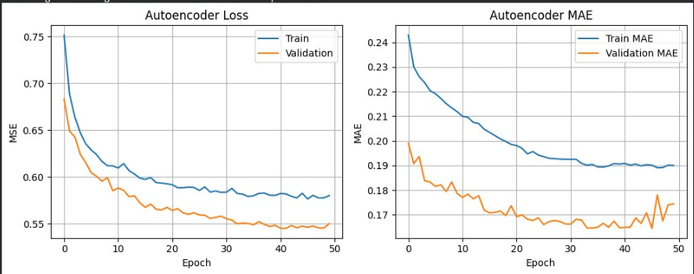
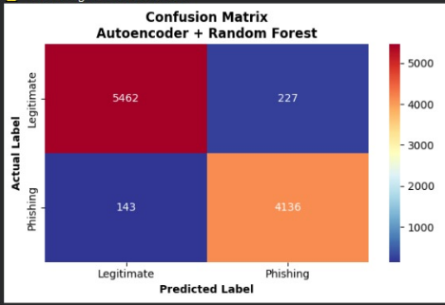
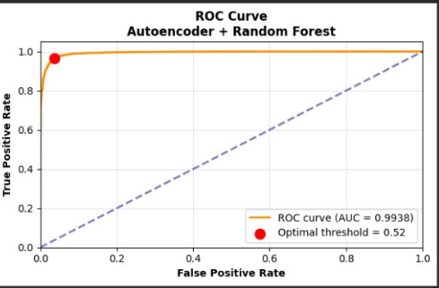
GRAPHS

Slide 12
Thank you

